Slide 1


SIMATS ENGINEERING
CAPSTONE PROJECT TITLE
Food Delivery System Using OOP Concepts
CSA1103
OBJECT ORIENTED ANALYSIS AND DESIGN
FOR INFORMATION SYSTEM
SUPERVISOR
Dr R DHANALAKSHMI (PROFESSOR)
Mrs S SARANIYA(ASSOCIATE PROFESSOR)
DEPARTMENT OF CSE
PRESENTED BY
ROHAN KUMAR A(192471013)
V.M.HARIHARA PARASATH (192421393)

Slide 2

ABSTRACT
The aim of this project is to design a food delivery system using Object-Oriented Programming (OOP) principles.
The system will efficiently manage restaurants, menus, customer orders, and payments, while applying encapsulation, inheritance, and polymorphism.
The design focuses on creating a modular, scalable, and maintainable architecture that can be easily extended or modified in the future.

Slide 3
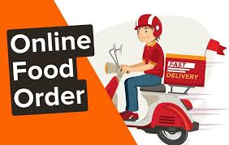
INTRODUCTION
A food delivery system is an application that connects customers with restaurants, allowing them to browse menus, place orders, and make payments online.
Using Object-Oriented Programming (OOP) principles, such a system can be designed in a structured and modular way. OOP helps in organizing the system into classes like Restaurant, Menu, Order, and Customer

Slide 4
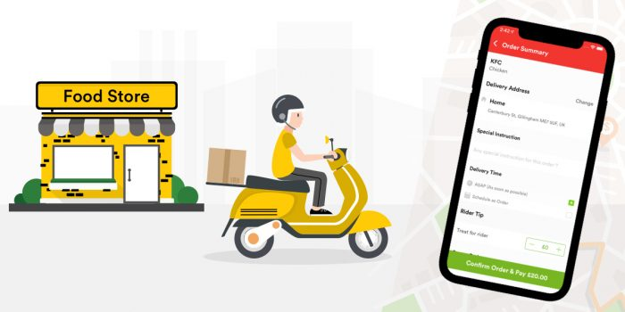
P
PROJECT OBJECTIVES:
To design an efficient food delivery system using OOP concepts.
To manage restaurants, customers, menus, and orders effectively.
To ensure secure payments and scalable system performance.
SIGNIFICANCE:
Helps simplify and automate food ordering and delivery processes.
Enhances user experience through efficient and reliable service.
Demonstrates the practical use of OOP concepts in real-world applications.
SCOPE:
overs restaurant, menu, order, and customer management using OOP concepts.
Includes order tracking, payment handling, and delivery management features.
Can be expanded to support multiple restaurants and real-time updates.

Slide 5
METHODOLOGY OVERVIEW
The food delivery system is developed using Object-Oriented Programming (OOP) methodology to ensure modularity and scalability.
The process begins with system analysis to identify the key entities such as Restaurant, Menu, Customer, and Order.
UML diagrams like use case, class, and sequence diagrams are designed using tools such as Umbrello UML Modeller to visualize the structure and interactions.

Slide 6
PROBLEM IDENTIFICATION & ANALYSIS
DESCRIPTION OF THE PROBLEM:
In the current scenario, many food delivery processes face challenges such as inefficient order management, lack of data integration between restaurants and customers, and difficulty in tracking payments and delivery status.
Traditional systems often rely on manual operations, leading to errors, delays, and poor customer satisfaction
EVIDENCE OF THE PROBLEM:
Recent studies and real-world observations show that many food delivery services struggle with order errors, delayed deliveries, and inefficient communication between customers and restaurants.
Manual order tracking often leads to confusion, lost data, and poor customer experience.

Slide 7
MODULE 1
Restaurant & Menu management
Restaurant and Menu Management involves organizing and maintaining details about different restaurants and their available dishes
Each restaurant has specific information such as name, location, contact details, and operating hours
The menu section stores items offered by the restaurant, including item names, prices, and descriptions.
Display menus to customers in real time.
Track item availability and restaurant status (open/closed).

Slide 8
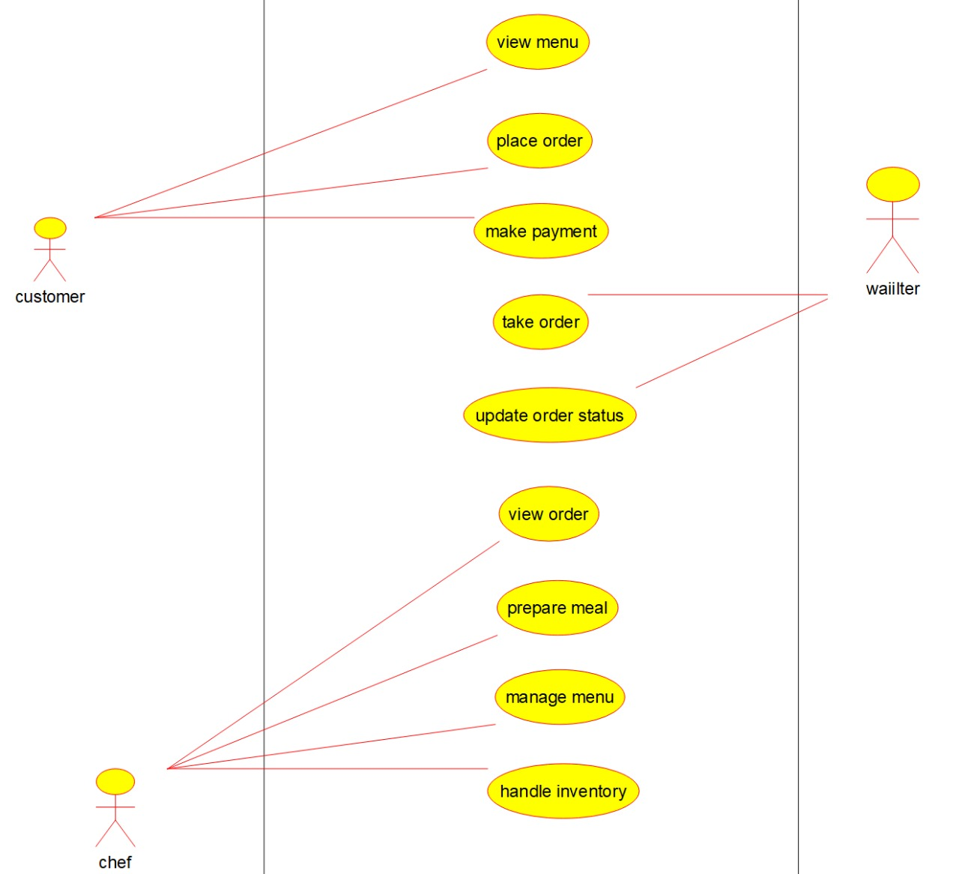
UML DIAGRAM
USECASE DIAGRAM

Slide 9
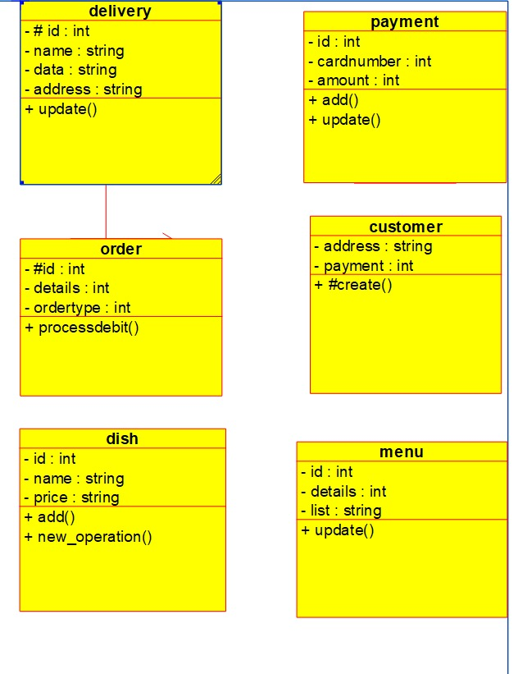
UML DIAGRAM
CLASS DIAGRAM

Slide 10
MODULE 2
Customer & Order Management
Customer and Order Management focuses on handling customer details and their food orders efficiently.
The Customer class stores information such as name, contact number, and delivery address, while the Order class records order items, quantities, prices, and payment details.
This ensures accurate processing, personalized service, and smooth coordination between customers, restaurants, and delivery agents.
The system links each customer to their respective orders, enabling features like order tracking, payment verification, and order history.
Maintain order history and generate bills or invoices.
Track order status (confirmed, prepared, dispatched, delivered).

Slide 11
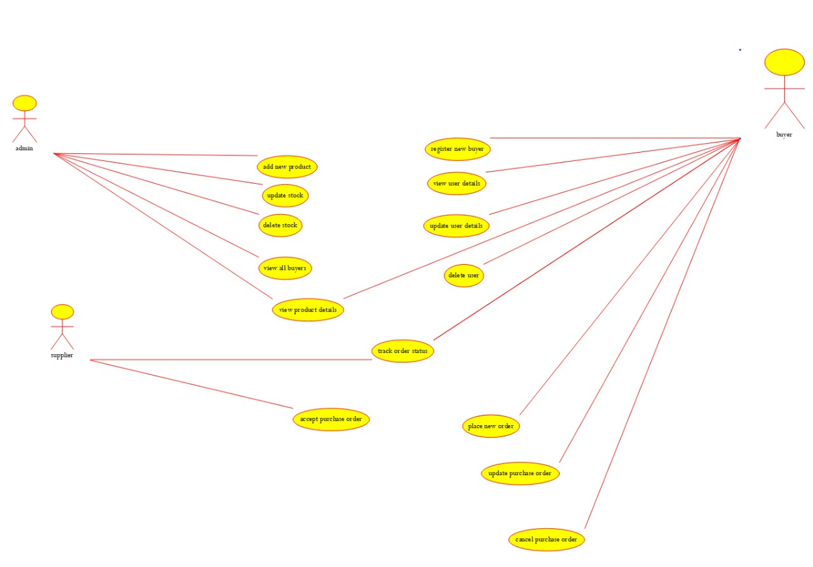
USE CASE DIAGRAM

Slide 12
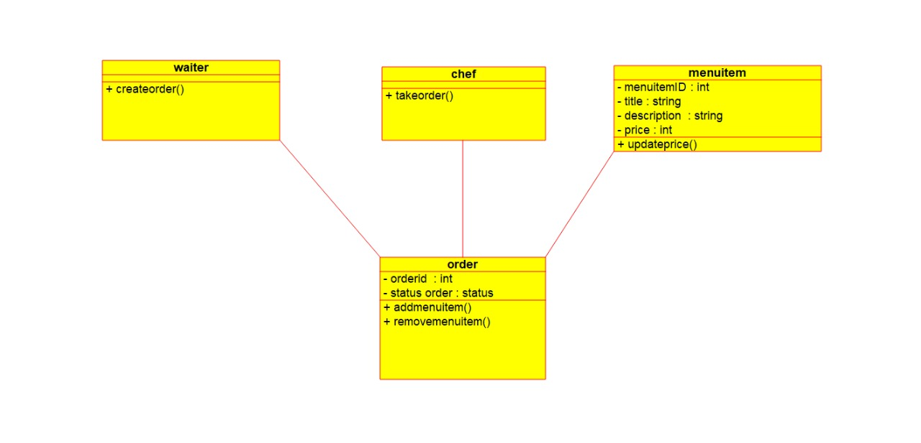
UML DIAGRAMS
CLASS DIAGRAM

Slide 13
Development and Design Process – Tools and Technologies
Development and Design Process:
The development and design process involves applying OOP concepts to structure the system into modular components such as Restaurant, Menu, Customer, and Order classes. The system is designed using UML diagrams to represent class relationships and interactions.
Tools and Technologies Used:
Programming Language: Python / Java / C++ (for implementing OOP concepts)
Database: MySQL or SQLite (for storing restaurant, customer, and order data)
Design Tools: UML diagrams using tools like StarUML or Lucidchart
IDE: Visual Studio Code / Eclipse / PyCharm for coding and debugging
Version Control: Git and GitHub for project management and collaboration

Slide 14
RESULT AND RECOMMENDATION
Evaluation of Results:
The system efficiently manages restaurants, menus, customers, and orders using OOP concepts.
It ensures smooth order processing, accurate tracking, and secure payment handling.
The design is scalable, maintainable, and easy to update for future enhancements.
CHALLENGES ENCOUNTERED:
Designing a flexible system structure to handle multiple restaurants and dynamic menus.
Ensuring accurate order tracking and payment processing without errors.
Implementing OOP concepts correctly for reusable and maintainable code.

Slide 15
Challenges Encountered and Overcome
Personal and Professional Growth:
Improved understanding and practical application of Object-Oriented Programming concepts.
Enhanced problem-solving, logical thinking, and system design skills.
Gained experience in developing real-world software and managing project workflows professionally.
Collaboration and Communication:
Strengthened teamwork skills by coordinating tasks and sharing responsibilities effectively.
Improved communication through regular updates, discussions, and feedback sessions.
Learned to document and present ideas clearly for smooth project execution.

Slide 16
APPLICATION OF ENGINEERING Ethical Standards
Engineering Standards:
ISO 9001:2015 (Quality Management Systems) – Ensures a systematic and well-structured validation process to maintain the accuracy, efficiency, and quality of the food delivery system modules.
ISO 9001:2015 (Quality Management Systems) – Focuses on maintaining proper documentation for every stage of development to ensure reproducibility, traceability, and smooth auditing of processes.
By following these standards, the project achieves reliable performance, improved consistency, and continuous quality improvement, ensuring professional engineering practices.
ETHICAL STANDARDS:
Safety and Transparency (IEEE 7.8.1, 7.8.2) – Ensures that all processes are carried out safely and transparently, minimizing risks and maintaining research integrity through reproducible and accountable practices.
Responsible Use and Prevention of Harm (IEEE 7.8.5, ISO 26000) – Promotes ethical responsibility by preventing misuse or unethical applications, ensuring that the system is used strictly for authorized and beneficial purposes.
Data Security and Quality Compliance (ISO 27001, ISO 9001) – Safeguards all stored data through secure handling and structured software development, ensuring reliability, efficiency, and protection against unauthorized access.

Slide 17
REFERENCES
Grady Booch, “Object-Oriented Analysis and Design with Applications,” Addison-Wesley, 3rd Edition, 2007.
Robert Lafore, “Object-Oriented Programming in C++,” Sams Publishing, 4th Edition, 2002.
Herbert Schildt, “Java: The Complete Reference,” McGraw-Hill, 11th Edition, 2019.
Ian Sommerville, “Software Engineering,” Pearson Education, 10th Edition, 2015.
ISO 9001:2015, Quality Management Systems — Requirements, International Organization for Standardization, 2015.
IEEE Standard 830-1998, IEEE Recommended Practice for Software Requirements Specifications, IEEE Computer Society, 1998.
Martin Fowler, “UML Distilled: A Brief Guide to the Standard Object Modeling Language,” Addison-Wesley, 3rd Edition, 2004.
“Online Food Delivery System Using OOP Concepts,” International Journal of Computer Applications, Vol. 182, No. 21, 2023.
of Indian Standards (BIS), Software System and Documentation Standards, Government of India, 2020.
“Bureau Design and Implementation of Online Food Ordering System,” International Research Journal of Engineering and Technology (IRJET), Vol. 9, Issue 4, 2022.

Slide 18
conclusion and Future enhancements
Conclusion
Engineering and ethical standards ensure safety, quality, and professionalism in all fields.
They provide guidelines for consistency and reliability, reducing errors and risks.
Adherence to standards builds trust, accountability, and efficiency in industries and organizations.
Future Enhancements
Update standards regularly to keep pace with technological advancements and new materials.
Integrate digital tools and AI for monitoring compliance and improving efficiency.
Expand global collaboration to harmonize standards and ensure interoperability across countries.

Slide 19
Thank You
Query Please

